Slide 1
Superstore Sales Dashboard
Built in Power BI | Date: 25-April-2025
Md Kaif

Slide 2
Dashboard Objective
Content:
Analyze total sales and order performance.
Track monthly sales trends.
Identify best performing regions and product categories.
Enable dynamic filtering by year, category, and region for deeper insights.

Slide 3
Key Metrics and Features
KPI | Feature
Total Sales | Date Range Slicer
Total Orders | Region and Category Slicers
Total Profit | Interactive filtering and drilldown
Sales by Category | Dynamic charts update
Sales by region | Dynamic charts update

Slide 4
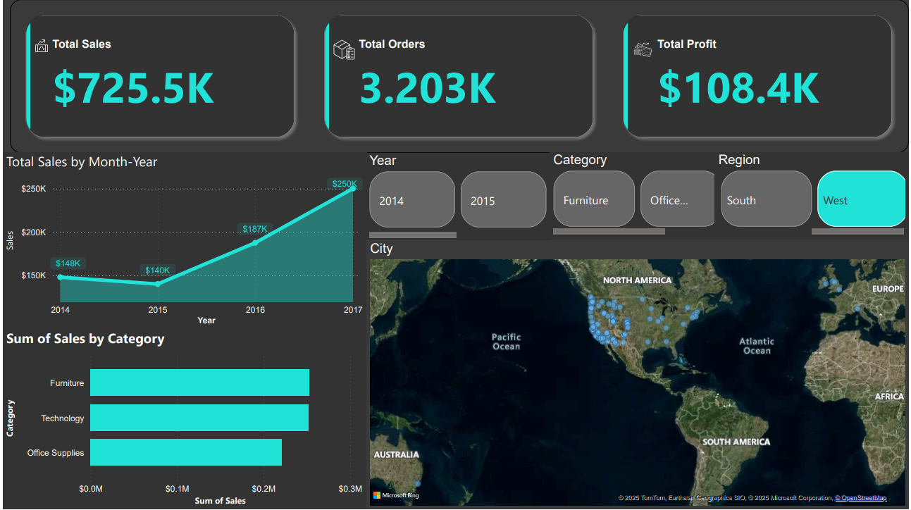
Final Dashboard

